Slide 1
Module-1 PostgreSQL Replication

Slide 2
Module Objective
Introduction to Replication
Reasons for Replication
Master/Slave Configuration
Warm/Hot Standby
Types of Replication
Replication Modes
Models of Replication

Slide 3
Introduction to Replication
The Process of copying data from a PostgreSQL database server to another server is called PostgreSQL Replication.
The intend is one or more standby servers ready to take over operations if the primary server fails.
The Source database server which sends the data is usually called the Master server.
The Server receiving the copied data is called the Replica/Standby server.

Slide 4
Why Replication?
High availability: refers to the ability of having an up to date copy of your database at all times. This means that in the event of a failure of your main database, the standby copy can be promoted to main and you can start receiving traffic.
Load balancing: practice of distributing incoming requests to your application in a way that is balanced so that no particular database experiences an uneven workload. With replication, this is possible since multiple copies of the data exist at any point in time.
Disaster recovery: is the need for effective disaster recovery in the event of a systemic failure.
Data Migration: To upgrade database server hardware or patches.

Slide 5

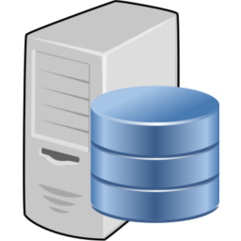
Master/Slave Configuration
Hot Standby
Warm Standby
Master Server
Slave Server

Slide 6
Build in Replication Types
Physical Replication:
File-based log shipping
Streaming replication
Physical replication replicate all databases.
Cannot Replicate between two different major versions or platforms.
Logical Replication:
Replicating data objects and their changes based upon their replication identity (usually a primary key).
Support table-level data synchronization.
Consolidating multiple databases into one single entity. (Analytics)

Slide 7
Replication Modes
Asynchronous Mode of Replication
Transactions on the master server can be declared complete when the changes have been done on just the master server.
These changes are then replicated to the replicas later in time.
The replica servers can remain out-of-sync for a certain duration, which is called a replication lag.
Synchronous Mode of Replication
Transactions on the master database are declared complete only when those changes have been replicated to all the replicas.
Replica servers must all be available all the time for the transactions to complete on the master.

Slide 8
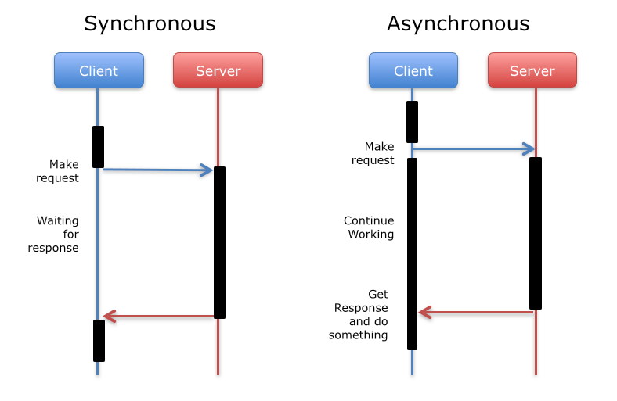

Replication Modes

Slide 9
Replication Models
Single-Master Replication
Changes to table rows in a designated master database server are replicated to one or more replica servers.
The replicated tables in the replica database are not permitted to accept any changes (except from the master).
Single-Master Replication is also called unidirectional, since replication data flows in one direction only, from master to replica.
Multi-Master Replication
Changes to table rows in more than one designated master database are replicated to their counterpart tables in every other master database.
In this model conflict resolution schemes are often employed to avoid problems like duplicate primary keys.
Multi-Master Replication is also called bidirectional, Since replication data flows in both the directions.

Slide 10
Thank you. ☺

